Slide 1




Storeflow Creator: Kurai Masuta
YOUR SMART PYTHON COACH FOR SPEED, ACCURACY, AND SEAMLESS ORDER PICKING.

Slide 2
Intro/prompts
What was the idea? - A system that will help boost efficiency and reduce errors for retail stores • What source code/tutorials did you find? – Used class notes and basic python input/loop examples. 3) How did your project develop? At first, the target was a couple of tips based on the store but developed into asking for number or items, orders, and checklists. • What surprised you? - How it would run in IDLE. How did the scope change? - It went from giving the worker a simple suggestion to a short but thorough walkthrough. Why? - I realized I can add more to it and make it have more features. • What roadblocks did you face? – Some were that the program would crash on a bad input, the loop structure kept repeating wrong, and the tips were repeated out of order. How did you overcome them? - (show the code and changes you made to fix it) Fixes/changes shown on next slide. 4) Run it/Show the code. • Does it run? – Yes, it does. More shown in later slides. • What would you do next? – I can add more features, talked about on later slide.

Slide 3
Roadblock fixes (refer to next slide for full code)
Roadblock 1 - Program would crash on bad input
Added input validation, cleaning the input , and giving error messages instead of crashing.
Users could now retry or type “quit” to exit safely.
Roadblock 2 – Loop repeated even after saying “No”
Adjusted the loop logic and standardized the yes/no responses.
Now program only repeats when user clearly selects “yes”.
Roadblock 3 – Tips were repeated and/or out of order
Gave each store its own separate set of tips.
The program now shows correct tips in the right order every time.

Slide 4
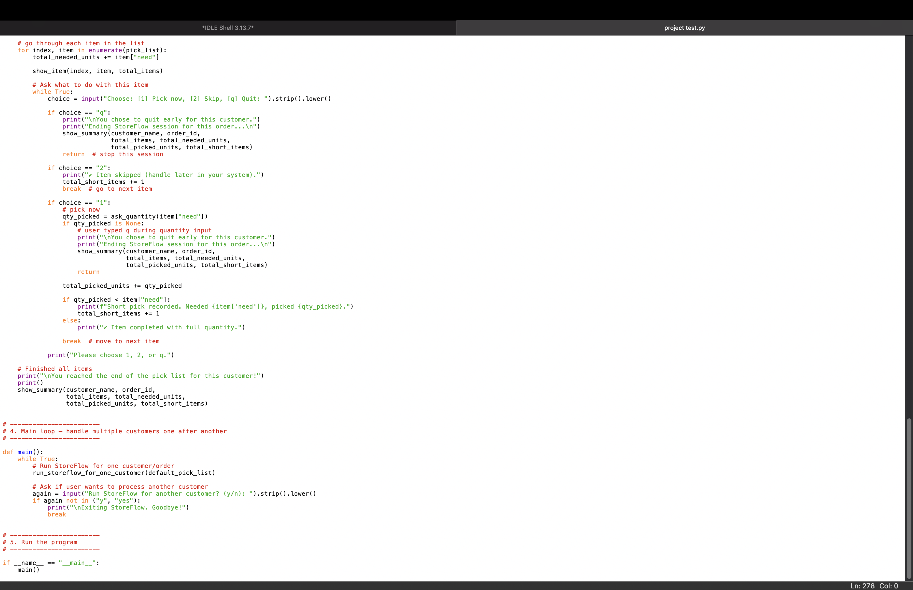

Slide 5

The Problem
Many companies and retail order teams struggle with being able to quickly and efficiently dispense and provide customers’ orders timely and accurately.
Common issues
Walking back forth across the store
Picking the wrong items and/or quantities
New employees struggle to get acquainted
It leads to refunds, unhappy customers, and unnecessary mistakes.

Slide 6

The fix: Storeflow
StoreFlow is a python powered system that will help employees and businesses be more productive and better overall.
Stores like Walmart and Target can use it
Campus stores like the student center can utilize it
It would greatly benefit Instacart systems
Employees/staff can easily learn and put it into use

Slide 7
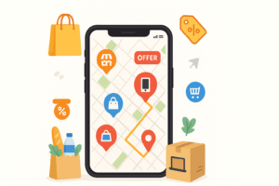
How it works
Asks for:
Customer name
Order ID
Uses pick list of items:
Name, SKU, zone, aisle, location, quantity needed
For each Item:
Shows where it is
Lets the worker: Pick, Skip, or Quit

Slide 8

Error prevention and coaching
Warns if worker tries to pick more items, then needed
Tracks units needed vs. units picked
At the end, shows accuracy percentage and tips on how to be better next time

Slide 9
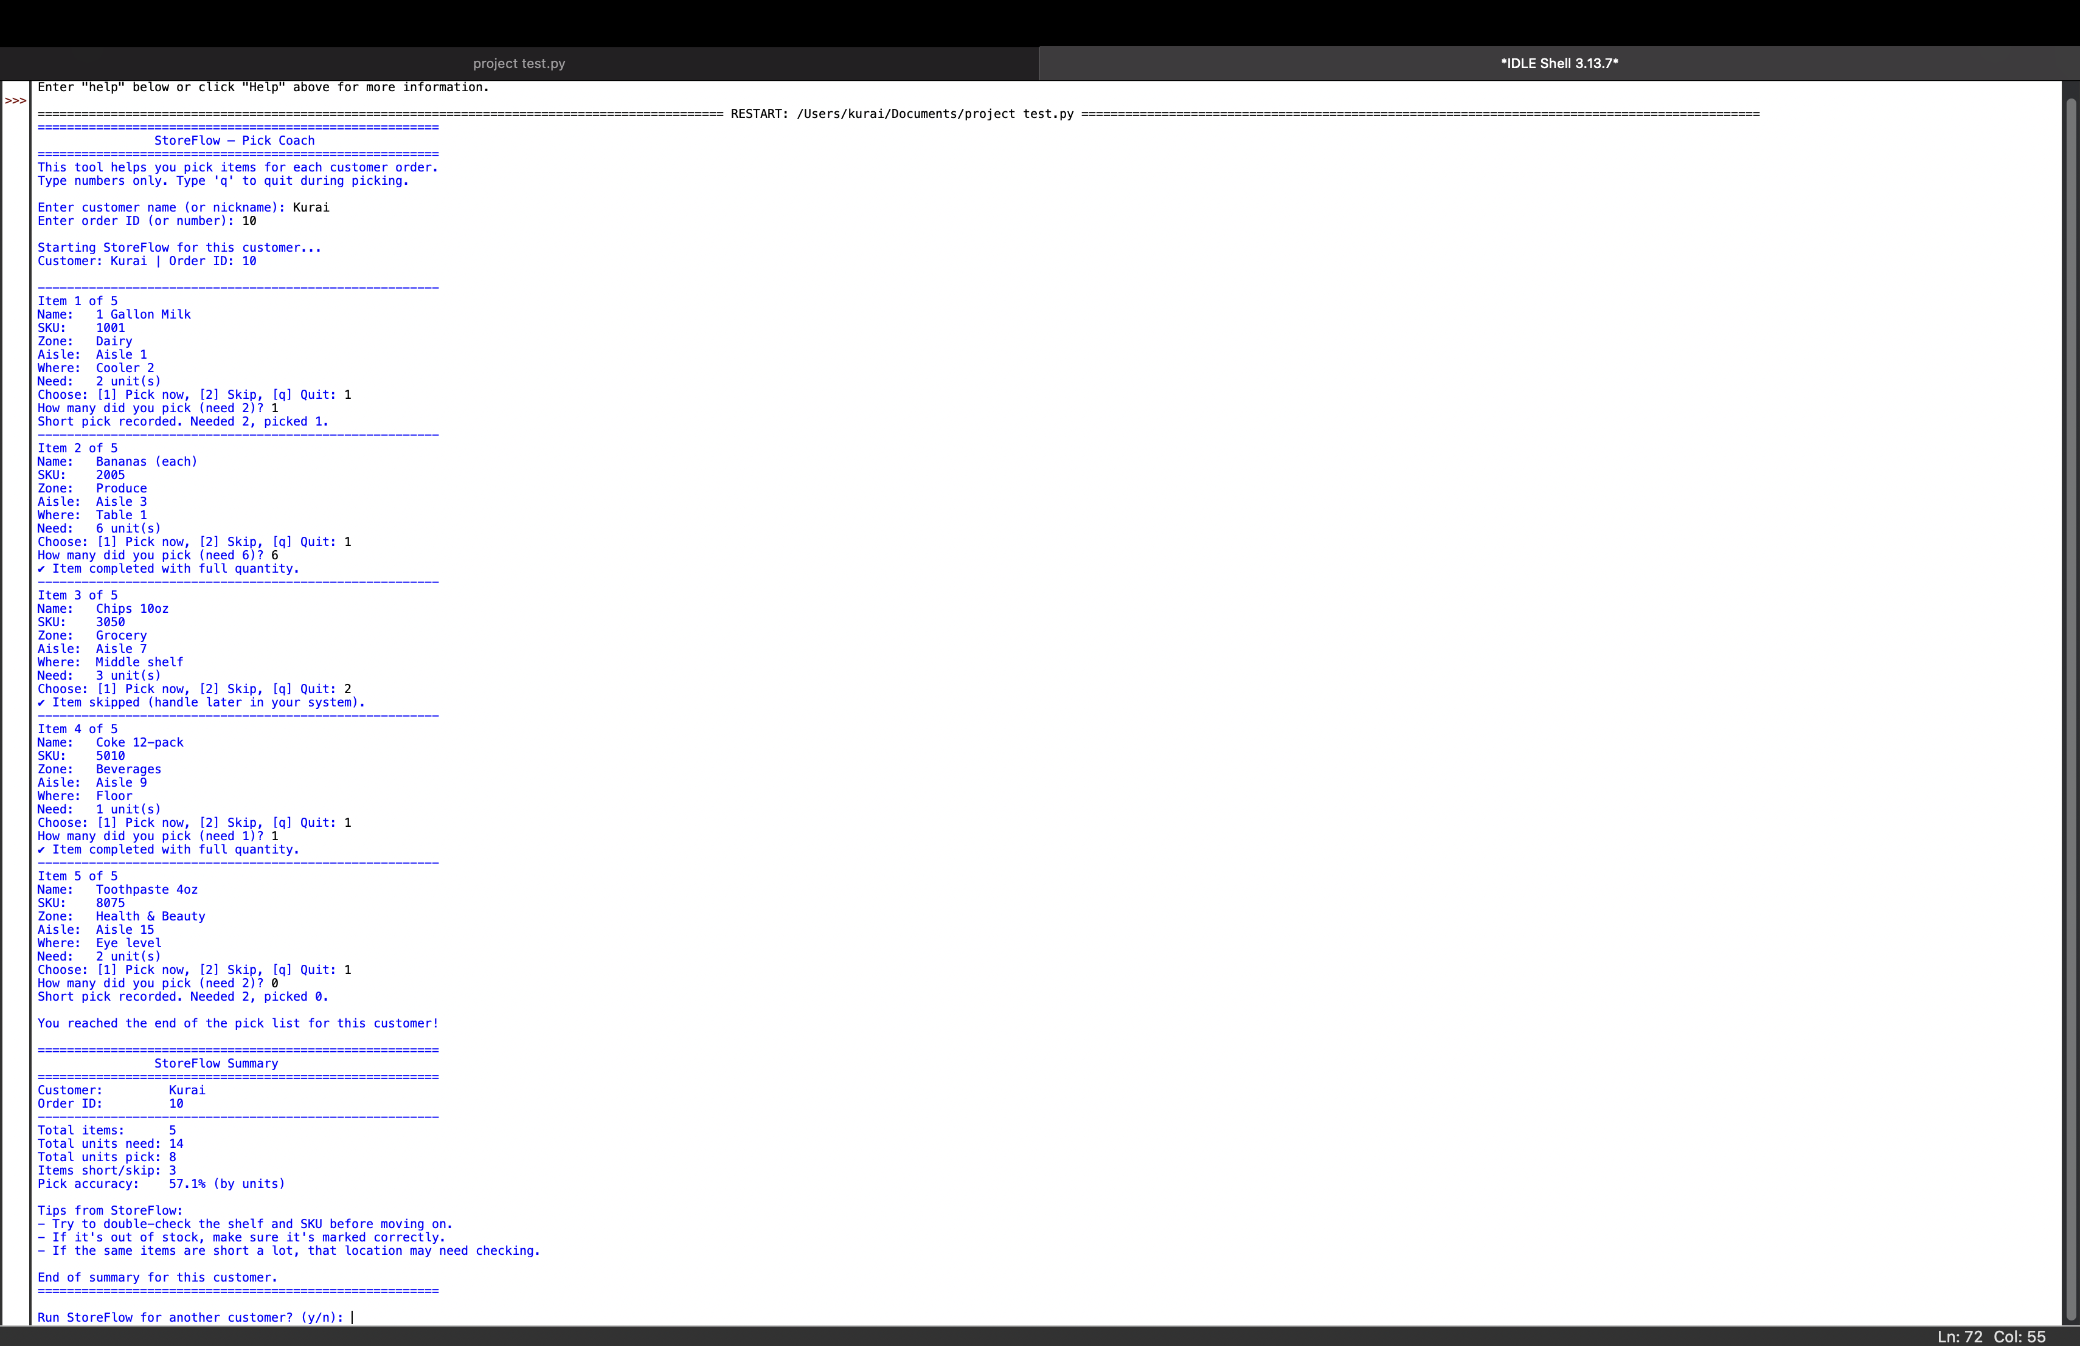
Example of system at work (Presenter Note: Now go to show in IDLE during presentation)
This is a screenshot of a test run/example of me running the system as a user of it would. Larger zoom of output on next slide.
This a screenshot of the code itself.
Notes:
Go to IDLE to show it ran

Slide 11

Technologies used/involved
I used the language of python in IDLE to configure my code.
Input & Output – interacts with users through questions
Lists & Dictionaries – Used to store item information
If/Else Statement – Used to make decisions (pick, skip, quit)
Loops – Used to go through each item in the pick list
Functions – Organize the code into simple parts

Slide 12

Things I can add/Future improvements
Time tracking for data metrics.
The ability to compare with different stores and modes.
Turn into simple mobile app.
Add route optimization throughout the store for order pickers.

Slide 13

Conclusion
All in all, StoreFlow help reduce order errors and benefits businesses and employees immensely.
My experience as an employee working with online orders as well as a customer picking up my orders gave the idea to produce this project/system.

